Slide 1
Wind generation system

Slide 2
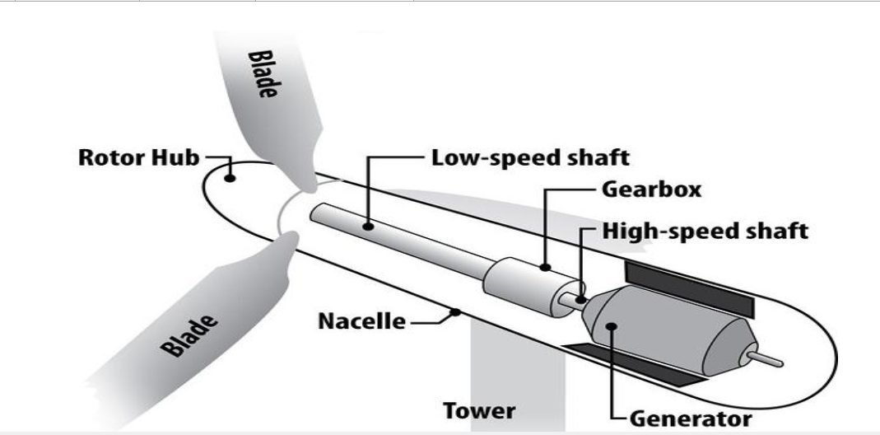

Slide 3
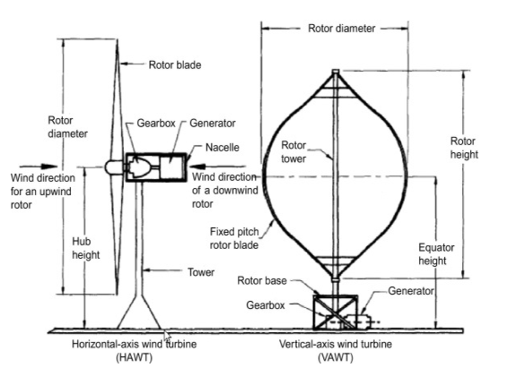

Slide 4
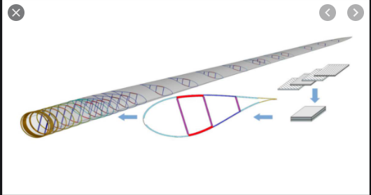

Slide 5
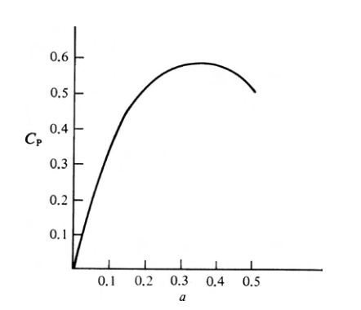

Slide 6
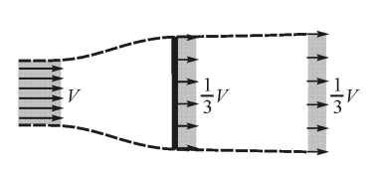

Slide 7
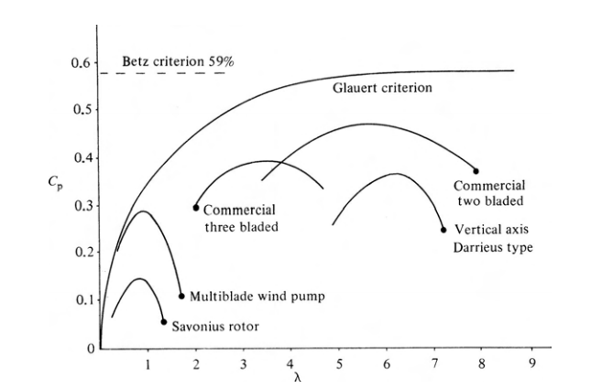

Slide 8
CP-λ curve.
Once the blade has been designed for optimum operation at a specific design tip speed ratio (defined as the ratio between the blade tip speed and the wind speed), the performance of the rotor over all expected tip speed ratios needs to be determined. For each tip speed ratio, the aerodynamic conditions at each blade section need to be determined. From these, the performance of the total rotor can be determined. The results are usually presented as a graph of power coefficient CP (defined as the ratio between the rotor power and the dynamic power in the wind) versus the tip speed ratio λ . This graph is called the CP-λ curve.
The shape of this curve be made plausible with the following reasoning:

Slide 9
At λ = 0 the rotor does not rotate and hence cannot extract power from the wind
At very high λ (here at λ=12) the rotor runs so fast that it seen by the wind as a completely blocked disc. The wind flows around this "solid" disc (as if it was a solid building), so there is no mass transport (wind) through the rotor, and hence no possibility to extract energy from a moving mass (the wind).
Somewhere between λ=0 and λ=12 there will be an optimum value for which the maximum power is extracted. This will be the condition in which the (average) velocity at the rotor disc is 2/3th of the wind speed according to Betz law.

Slide 10
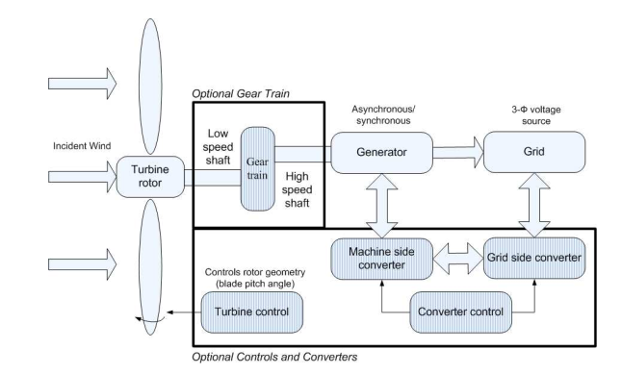

Slide 11
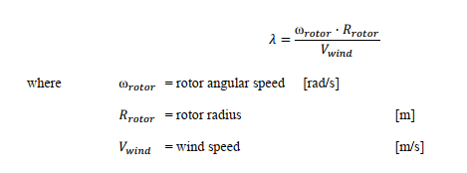
The tip-speed ratio or TSR, denoted by λ, is the ratio of the blade-tip linear speed to the wind speed [42]. The TSR determines the fraction of available power extracted from the wind by the wind turbine rotor.

Slide 12

Rotor power coefficient (CP) calculation
The TSR, together with the user-defined blade pitch angle β, are used to calculate the rotor power coefficient, denoted by CP. The rotor power coefficient is a measure of the rotor efficiency and is defined as:

Slide 13
Pitch Control:
Blade pitch control is a feature of nearly all large modern horizontal-axis wind turbines. It is used to adjust the rotation speed and the generated power. While operating, a wind turbine's control system adjusts the blade pitch to keep the rotor speed within operating limits as the wind speed changes.

Slide 14
Pitch controls adjust the blades in wind turbines by rotating them so that they use the right fraction of the available wind energy to get the most power output, all the while ensuring the turbine does not exceed its maximum rotational speed. This maintains the turbine’s safety in the event of high winds, loss of electrical load, or other catastrophic events.

Slide 15
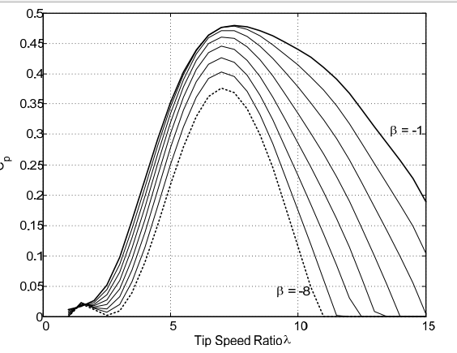

Slide 16
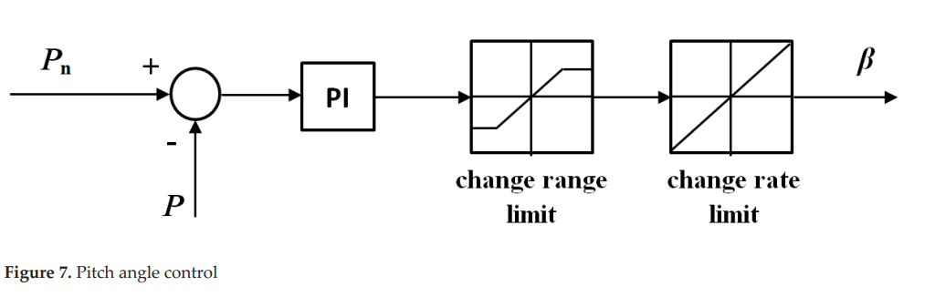

Slide 17
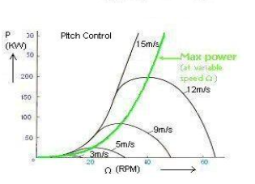

Slide 18
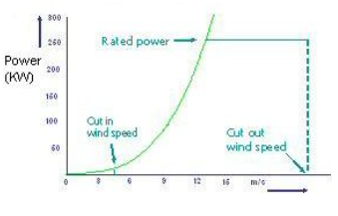

Slide 19
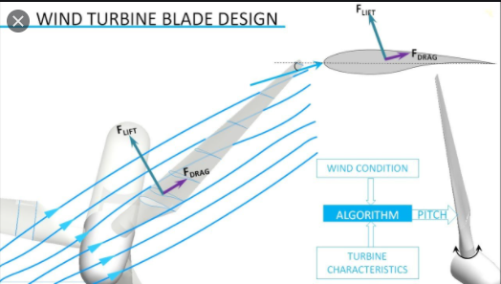

Slide 20
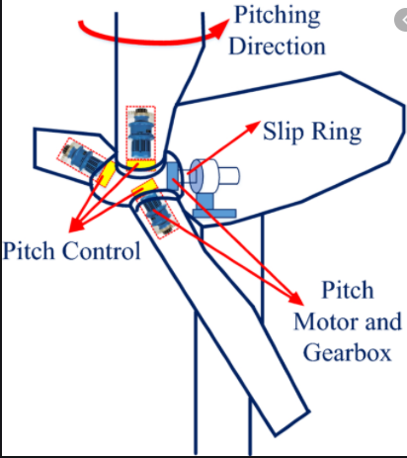

Slide 21
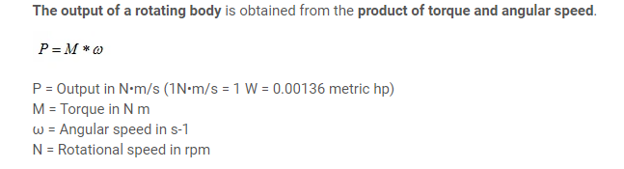

Slide 22
Yaw Control Mechanism
The wind turbine is said to have a yaw error, if the rotor is not perpendicular to the wind. A yaw error implies that a lower share of the energy in the wind will be running through the rotor area. (The share will drop to the cosine of the yaw error, for those of you who know math).

Slide 23
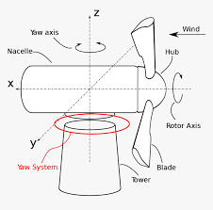

Slide 24
There are four types of wind turbine generators (WTGs) which can be considered for the various wind turbine systems, those are:
Direct Current (DC) Generators
Alternating Current (AC) Synchronous Generators
AC Asynchronous Generators, and
Switched Reluctance Generators.

Slide 25
DC Generators:
In conventional DC machines, the field is on the stator and the armature is on the rotor. The stator comprises a number of poles which are excited either by permanent magnets or by DC field windings. If the machine is electrically excited, it tends to follow the shunt wound DC generator concept.
An example of the DC wind generator system is illustrated in Fig. 6. It consists of a wind turbine, a DC generator, an insulated gate bipolar transistor (IGBT) inverter, a controller, a transformer and a power grid

Slide 26
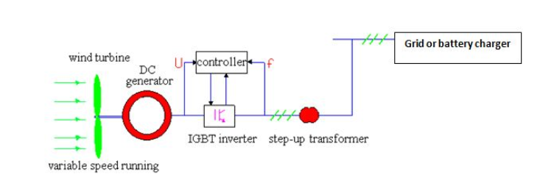

Slide 27
In general, these DC WTGs are unusual in wind turbine applications except in low power demand situations where the load is physically close to the wind turbine, in heating applications or in battery charging.
For shunt wound DC generators, the field current (and thus magnetic field) increases with operational speed whilst the actual speed of the wind turbine is determined by the balance between the WT drive torque and the load torque

Slide 28
AC Synchronous Generator Technologies
Since the early time of developing wind turbines, considerable efforts have been made to utilize three-phase synchronous machines. AC synchronous WTGs can take constant or DC excitations from either permanent magnets or electromagnets and are thus termed PM syn‐ chronous generators (PMSGs) and electrically excited synchronous generators (EESGs), respectively.

Slide 29
When the rotor is driven by the wind turbine, a three-phase power is generated in the stator windings which are connected to the grid through transformers and power converters.
For fixed speed synchronous generators, the rotor speed must be kept at exactly the synchronous speed. Otherwise synchronism will be lost.

Slide 30
Permanent magnetic SG:
In recent decades, PM generators have been gradually used in wind turbine applications due to their high power density and low mass [39]. Often these machines are referred to as the permanent magnet synchronous generators (PMSGs) and are considered as the machine of choice in small wind turbine generators.
the rugged PMs are installed on the rotor to produce a constant magnetic field and the generated electricity is taken from the armature (stator) via the use of the commutator, sliprings or brushes.

Slide 31
The advantages of PMSGs include the elimination of commutator, slip rings and brushes so that the machines are rugged, reliable and simple. The use of PMs removes the field winding (and its associated power losses) but makes the field control impossible and the cost of PMs can be prohibitively high for large machines.
Because the actual wind speeds are variable, the PMSGs can not generate electrical power with fixed frequency. As a result, they should be connected to the power grid through ACDC-AC conversion by power converters.

Slide 32
It is also very attractive to use these permanent magnet machines for direct drive application.
Obviously, in this case, they can eliminate troublesome gearboxes which cause the majority of wind turbine failures. The machines should have large pole numbers and are physically large than a similarly rated geared machine.

Slide 33
AC Asynchronous Generators:
Whilst conventional power generation utilizes synchronous machines, modern wind power systems use induction machines extensively in wind turbine applications.
These induction generators fall into two types: fixed speed induction generators (FSIGs) with squirrel cage rotors (sometimes called squirrel cage induction generators-SQIGs) and doubly fed induction generators (DFIGs) with wound rotors.

Slide 34
When supplied with three-phase AC power to the stator, a rotating magnetic field is established across the airgap. If the rotor rotates at a speed different to synchronous speed, a slip is created and the rotor circuit is energized.
However, induction machines draw reactive power from the grid and thus some form of reactive power compensation is needed such as the use of capacitors or power converters. For fixed-speed induction generators, the stator is connected to the grid via a transformer and the rotor is connected to the wind turbine through a gearbox

Slide 35
Clearly, fixed speed induction generators are limited to operate only within a very narrow range of discrete speeds. Other disadvantages of the machines are related to the machine size, noise, low efficiency and reliability. These machines have proven to cause tremendous service failures and consequent maintenance.

Slide 36
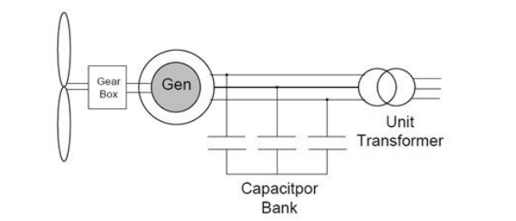

Slide 37
The fixed-speed concept has been successfully applied in SCIG wind systems. The drive train applies multiple-stage gearbox and a SCIG is directly connected to the grid via a transformer. To support the grid, external reactive power compensation and soft starter are necessary.

Slide 38
The limited variable-speed system is an improved version of the SCIG type but it uses a wound rotor induction generator instead, which allows the stator to be connected to the grid, and the rotor to have a variable resistance controlled by a power converter.
Through the control of rotor resistance, the slip of the generator is varied.

Slide 39
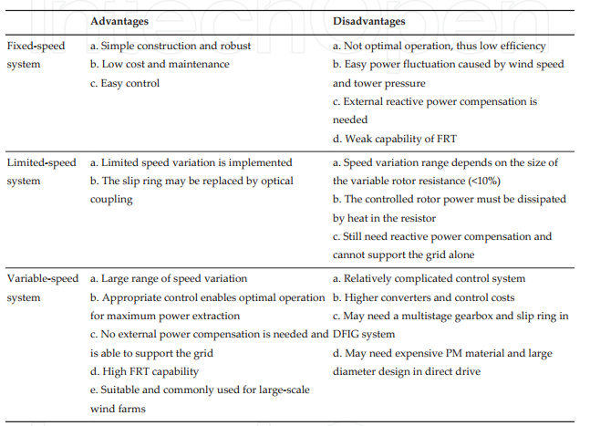

Slide 40
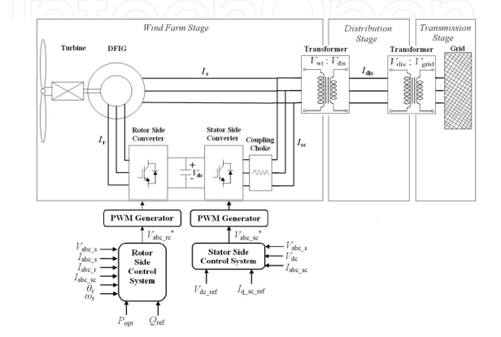
Doubly Fed Induction Generators

Slide 41
In order to completely remove the reactive power compensation and control both active and reactive power independently, DFIG wind power system is one of most popular methods in wind energy applications.
The DFIG wind power system with associated back-to-back converter is a typical variable speed system, which complies with the topologies.

Slide 42
The generator stator windings are connected directly to grid (with fixed voltage and frequency of grid) while the rotor windings are fed by an AC/DC/AC IGBT-based PWM converter (back-to-back converter with capacitor dc-link), at variable frequency through slip rings and brushes.
In the DFIG topology, the stator is directly connected to the grid through transformers and the rotor is connected to the grid through PWM power converters. The converters can control the rotor circuit current, frequency and phase angle shifts. Such induction generators are capable of operating at a wide slip range (typically ±30% of synchronous speed). As a result, they offer many advantages such as high energy yield, reduction in mechanical stresses and power fluctuations, and controllability of reactive power

Slide 43
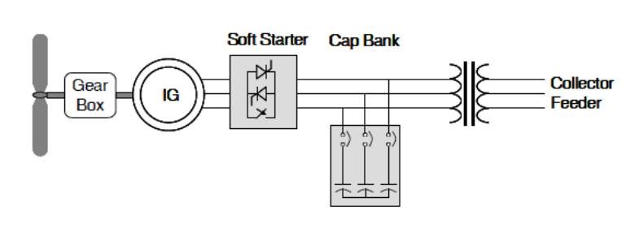
Types of Wind Turbines

Slide 44
Squirrel-cage Induction Generator (SCIG) connected directly to the step up transformer.
The turbine speed is fixed (or nearly fixed) to the electrical grid frequency.
It generates real power (P) when the turbine shaft rotates faster than the electrical grid frequency creating a negative slip (positive slip and power is motoring convention).

Slide 45
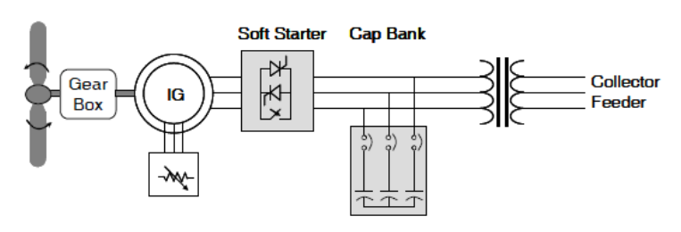
Limited Variable Speed (Type 2)

Slide 46
Wound rotor induction generators are connected directly to the WTG step-up transformer in a fashion similar to Type 1 with regards to the machines stator circuit, but also include a variable resistor in the rotor circuit.
This can be accomplished with a set of resistors and power electronics external to the rotor with currents flowing between the resistors and rotor via slip rings.
Alternately, the resistors and electronics can be mounted on the rotor, eliminating the slip rings—this is the Weier design.
The variable resistors are connected into the rotor circuit softly and can control the rotor currents quite rapidly so as to keep constant power even during gusting conditions, and can influence the machine’s dynamic response during grid disturbances.

Slide 47
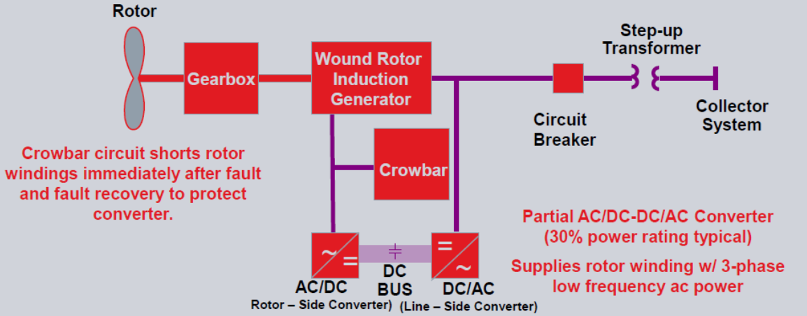
Variable Speed with Partial Power Electronics Conversion (Type3)

Slide 48
The Type 3 turbine, known commonly as the Doubly Fed Induction Generator (DFIG) or Doubly Fed Asynchronous Generator (DFAG), takes the Type 2 design to the next level, by adding variable frequency ac excitation (instead of simply resistance) to the rotor circuit.
• The additional rotor excitation is supplied via slip rings by a current regulated, voltage-source converter, which can adjust the rotor currents’ magnitude and phase nearly instantaneously.
• This rotor-side converter is connected back-to-back with a grid side converter, which exchanges power directly with the grid

Slide 49
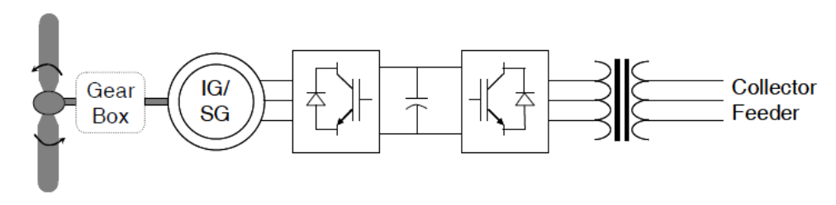
Variable Speed with Full Power Electronics Conversion (Type4)

Slide 50
The Type 4 turbine offers a great deal of flexibility in design and operation as the output of the rotating machine is sent to the grid through a full-scale back-to-back frequency converter. • The turbine is allowed to rotate at its optimal aerodynamic speed, resulting in a “wild” AC output from the machine. • In addition, the gearbox may be eliminated, such that the machine spins at the slow turbine speed and generates an electrical frequency well below that of the grid.
• The rotating machines of this type have been constructed as wound rotor synchronous machines, similar to conventional generators found in hydroelectric plants with control of the field current and high pole numbers, as permanent magnet synchronous machines, or as squirrel cage induction machines.

